Slide 1
RAN Meeting October 11, 2016 The Importance of Choosing the Correct Program/CFDA# By Teresa Hammitt and Deb Selke
Notes:
Mindy has asked me to continue the discussion she began regarding Cayuse activity codes, which are referred to as program codes on the accounting side.

Slide 2
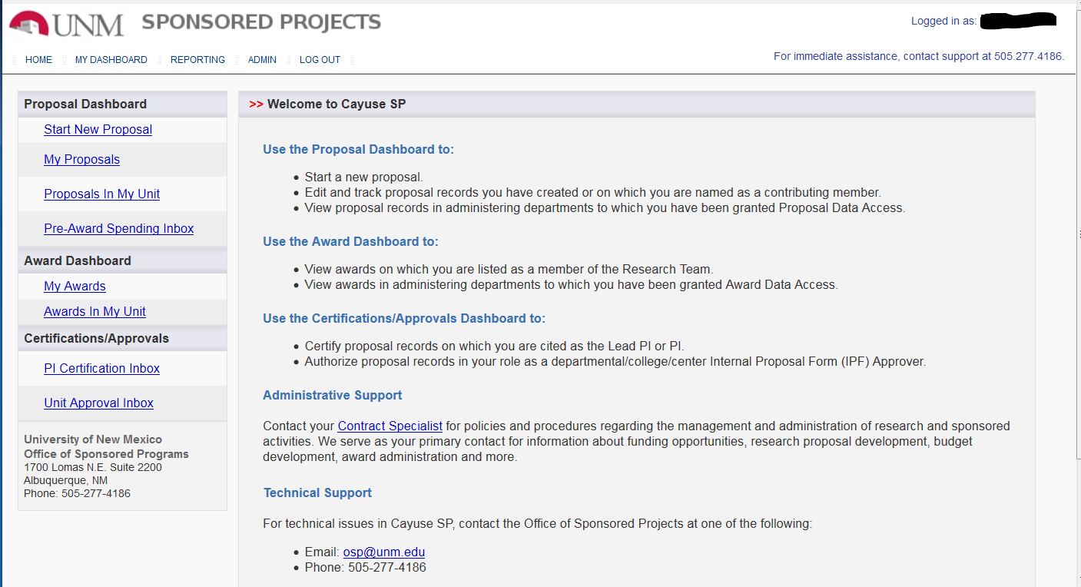
Notes:
Everything you enter into Cayuse, including the type of program and the CFDA number, is relevant to the Banner setup. The information you’ve provided, along with that entered by OSP, flows from OSP to C&G Accounting on a sheet we refer to as the Transmittal page.

Slide 3
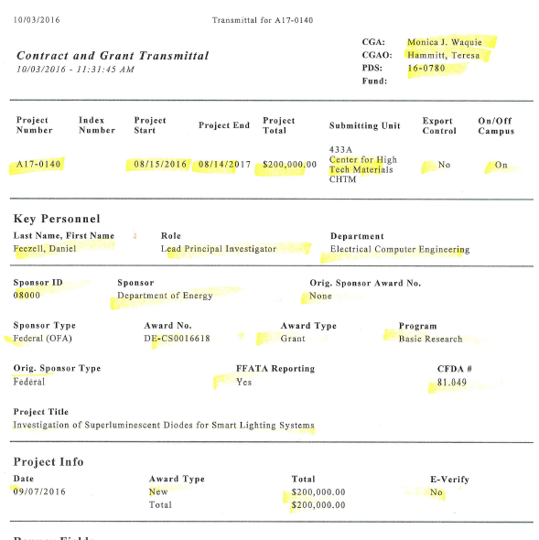
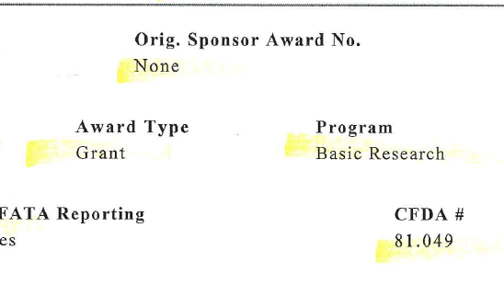
Notes:
Most of you have seen these and maybe wondered what it was used for. [Click to zoom]

Slide 4
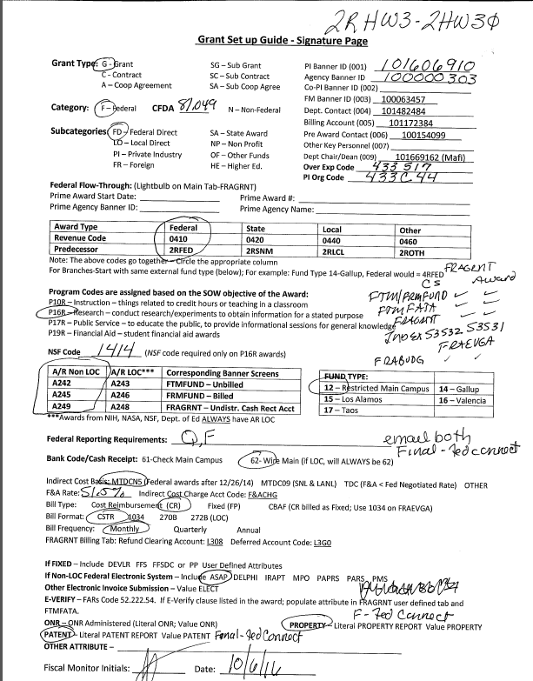
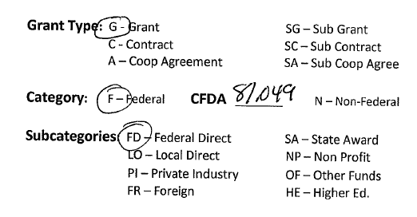
Notes:
We organize the relevant information from the Transmittal onto an internal document C&G Accounting completes prior to entering it into Banner.
(Click to zoom)

Slide 5
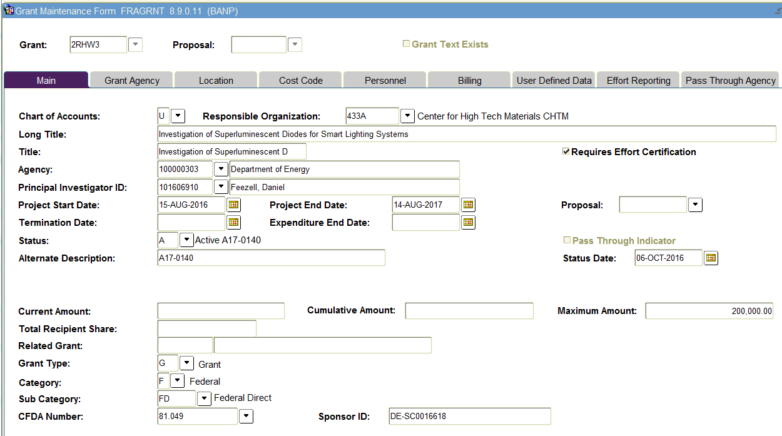
Notes:
Most of you are probably familiar with the Banner screen FRAGRNT.
(Click to zoom)

Slide 6
Award Types
Grant
Contract
Cooperative Agreement
Subaward of Grant
Subaward of Contract
Subaward of Cooperative Agreement
Non-Federal
Category
Federal
State Award
Non Profit
Other Funds
Higher Education
Subcategories
Federal Direct
Local Direct
Private Industry
Foreign
Notes:
The different categorization options in Banner …..

Slide 7
Notes:
Accurate presentation of our Audit reports is the real reason for the focus on correct entries.

Slide 8
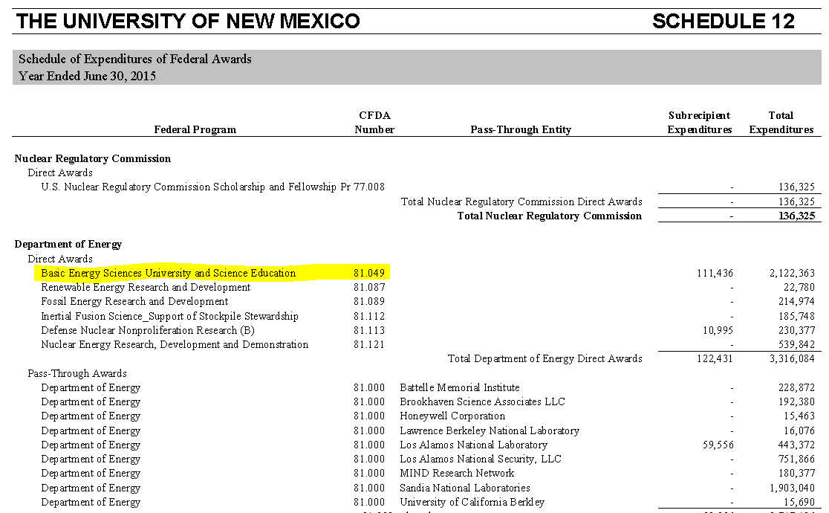
Notes:
Under Schedule 12, Schedule of Expenditures of Federal Awards (SEFA) we must list all Federal awards rolled up by CFDA number. NEXT SLIDE

Slide 9
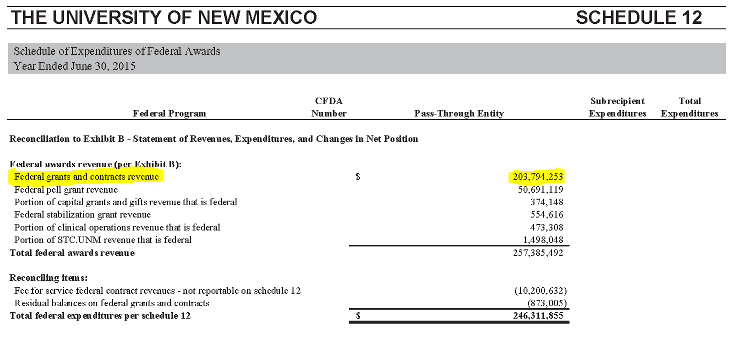
Notes:
We reconcile from the federal expenditures to Federal revenue.

Slide 10
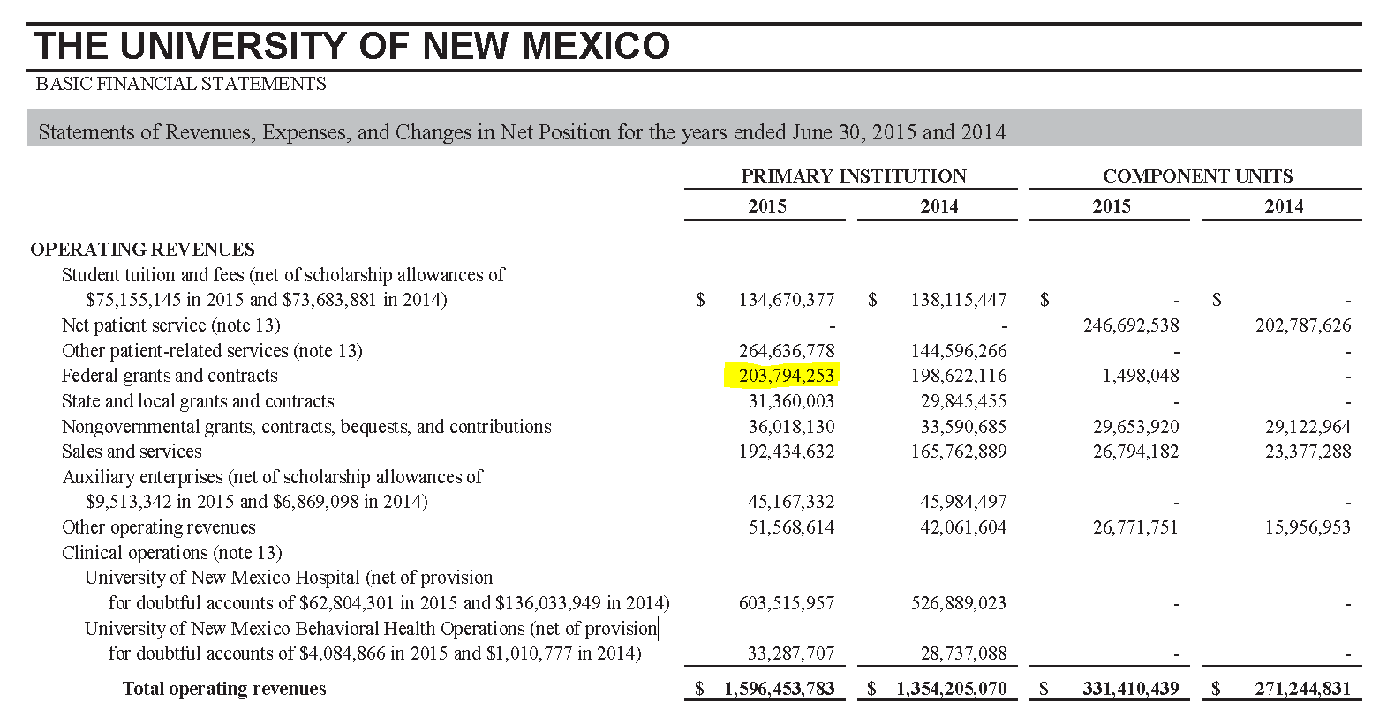
Notes:
Our C&G revenue is a separate line item on the Basic Financial Statements under Operating Revenues. As we are audited to the accuracy of our Financial Statements, it is extremely important that the original information NEXT SLIDE

Slide 11
Notes:
Is entered correctly into Cayuse – this is where it all starts.

Slide 12
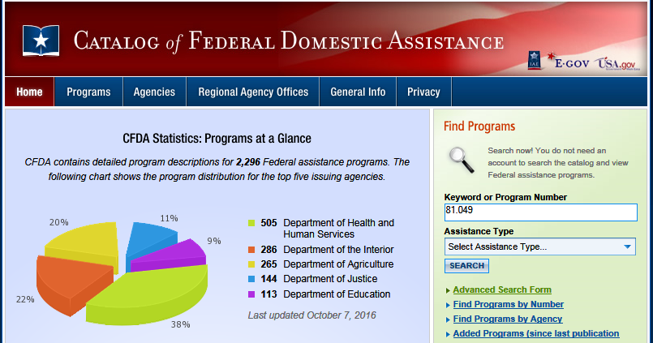
https://www.cfda.gov/
Notes:
You can get more information regarding the award through the CFDA number on cfda.gov

Slide 13
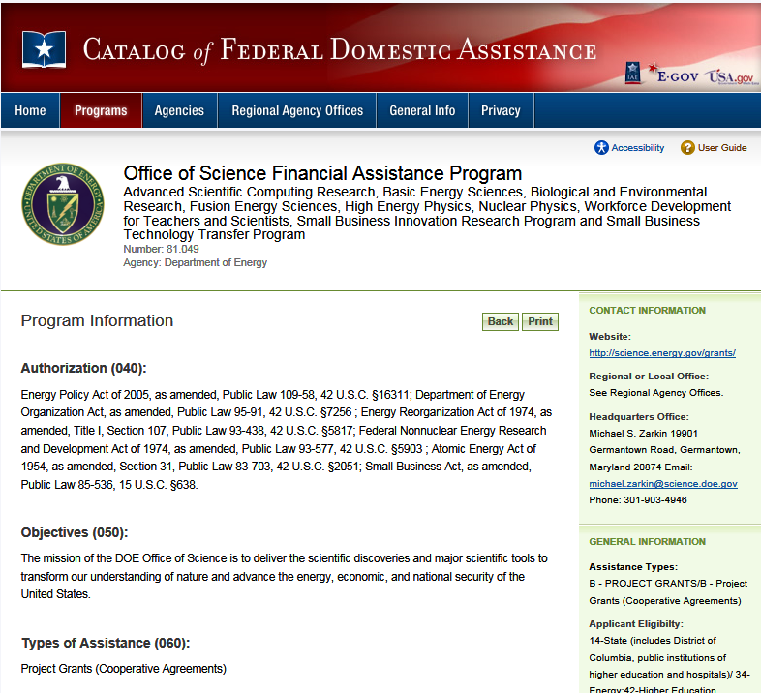
Notes:
The objectives show us this CFDA is for research

Slide 14
www.usaspending.gov/
Notes:
If you do not have a CFDA number or if you need clarification, you can go to … Enter the award number with no spaces or characters, then click on the award ID

Slide 15
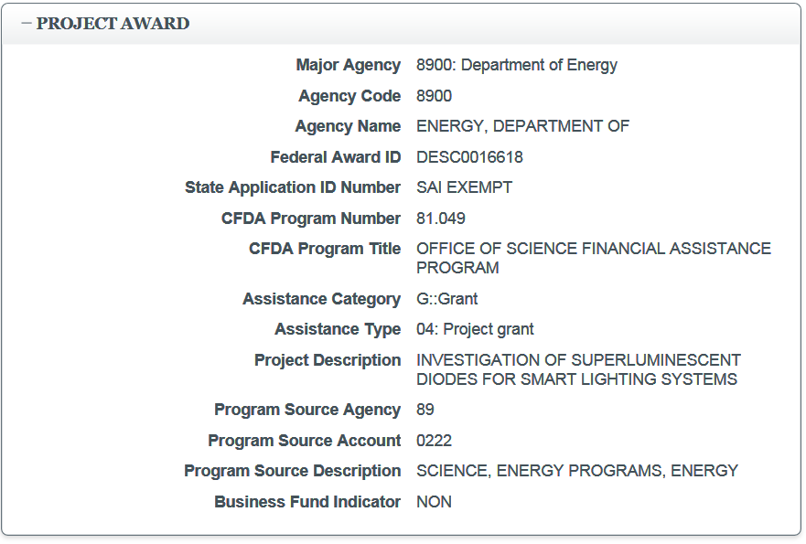
Notes:
Under the Project Award, you can see the CFDA# and the category (grant vs. coop vs. contract)

Slide 16
Notes:
Again, all of this ties back to the information entered in Cayuse

